Slide 1
Unit I
Introduction to DBMS
    Database Systems
    Data modeling
    Relational Model
DATABASE SYSTEM

Slide 2
Database Systems
Objectives:
What is a database and a database system?
Explain the characteristics of a database system
Data Abstraction
Database languages
Explain the concept of data independence and its importance
Explain the architecture of a database system
DATABASE SYSTEM

Slide 3
Database is a collection of coherent, meaningful , interrelated data.
A database management system is a system that allows inserting, updating, deleting & processing of a data.
DATABASE SYSTEM

Slide 4
Database system Applications
Banking
Airlines
Universities
Credit cards transactions
Telecommunications
Finance
Sales
Human resources
DATABASE SYSTEM

Slide 5
Purpose of database systems
In 1960’s, one way to keep the information on a computer is to store it in operating system files.
The system stores permanent record in various files and it needs different application programs to extract records from and add records to the appropriate files
DATABASE SYSTEM

Slide 6
Disadvantages of a file processing systems
Data redundancy and inconsistency
Difficulty in accessing data
Data isolation
Integrity problems
Atomicity problems
Concurrent access anomalies
Security problems
DATABASE SYSTEM

Slide 7
Characteristics of Database Systems
(Benefits of DBMS)
Performance (No data inconsistencies)
Minimal Redundancy
Data Integrity
Privacy and Security
Migration of Data
Data Independence
DATABASE SYSTEM

Slide 8
Data abstraction
A major purpose of database system is to provide users with an abstract view of the data
The system hides certain details of how the data are stored and maintained
Since many database users are not computer trained, developers hide the complexity from users through several levels of abstraction
DATABASE SYSTEM

Slide 9
Data abstraction
Physical level: describes how the data are actually stored (internal schema)
Logical level: describes what data are stored in the database and what relationship exist among those data (conceptual schema)
View level: describes only part of the entire database (external schema )
DATABASE SYSTEM

Slide 10
Schemas and instances
Databases change over time as information is inserted and deleted
The collection of information stored in the database at a particular moment is called an instance of the database
The overall design of the database is called the database schema
Database schema is not expected to change frequently
A displayed schema is called schema diagram

Slide 11



The three schema architecture
End Users
External
External
External
External Level
View A
View B
View N
external/conceptual mapping
Conceptual Level
Conceptual Schema
conceptual/internal mapping
Internal Level
Internal schema
Stored Database
DATABASE SYSTEM

Slide 12
Data independence
Data independence can be defined as the capacity to change the schema at one level of a database system without having to change the schema at the next higher level
Two types of data independence:
Logical data independence
Physical data independence
DATABASE SYSTEM

Slide 13
Data independence
Logical data independence
It is the capacity to change the conceptual schema without having to change external schemas or application programs
Physical data independence
It is the capacity to change the internal schema without having to change the conceptual schema. Hence the external schemas need not be changed as well
DATABASE SYSTEM

Slide 14
Data models
Data model is a set of data structures and conceptual tools used to describe the structure of a database
(data types, relationships, and constraints)
A data model provides a way to describe the design of a database at the physical, logical and view level
Most data models also include a set of basic operations for specifying retrievals and updates on the database
DATABASE SYSTEM

Slide 15
Data models
Different data models are
  Relational model:
  The Entity- Relationship model:
  Object based data model:
  Semistructured data model:
DATABASE SYSTEM

Slide 16
Data models
Relational model:
It uses a collection of tables to represent both data and the relationship among those data.
Each table has multiple columns and each column has a unique name
Each table contains records of a particular type
Most widely used data model
DATABASE SYSTEM

Slide 17
Data models
  The Entity- Relationship model:
The E-R model is a collection of basic objects called entities and of a relationship among these objects
An entity is a real world thing or object
It is widely used in database design
DATABASE SYSTEM

Slide 18
Data models
  Object oriented data model:
  Extending the E-R model with concept of encapsulation, methods(functions) and object identity
  The object relational data model combines features of the object oriented data model and relational data model
DATABASE SYSTEM

Slide 19
Data models
  Semistructured data model:
  It permits the specification of data where individual data items of the same type may have different set of attributes
The extensible Markup language (XML) is widely used to represent semistructured data
DATABASE SYSTEM

Slide 20
Database languages
Data definition language (DDL)
Specify database schema
Also used to specify additional properties of the data
The data values stored in the database must satisfy certain constraints
The DDL provides facility to specify such constraints
DATABASE SYSTEM

Slide 21
Database languages
Data manipulation language (DML)
Enables user to access or manipulate data
  Insertion of new information into the database
  Deletion of information from the database
  Modification of information stored in the database
Data query language (DQL)
  Retrieval of information stored in the database
DATABASE SYSTEM

Slide 22
Components and over all structure of a DBMS
The functional components of a database system can be divided into
Disk storage:
Databases require a large amount of storage space. Since main memory of computers can not store this much information, the information is stored on disk. Data are moved between disk storage and main memory as needed.
DATABASE SYSTEM

Slide 23
Disc storage has several data structure
Data files: which store the database itself
Data dictionary: which stores metadata about the structure (schema)of the database
Indices: which can provide fast access to data items. Hashing is an alternative to indexing that is faster in some but not all cases
DATABASE SYSTEM

Slide 24
The storage manager:
It is a program module that provides the interface between the low level data stored in the database and the application programs and queries submitted to the system
It is responsible for storing, retrieving and updating data in the database
DATABASE SYSTEM

Slide 25
The storage manager components include:
Authorization and integrity manager: tests for satisfaction of integrity constraints and checks the authority of users to access data
Transaction manager: ensures that the database remains in a consistent state despite system failures
File manager: manages the allocation of space on disk storage
Buffer manager: responsible for fetching data from disk storage into main memory and deciding what data to cache in main memory

Slide 26
The query processor components:
The query processor components include
DDL interpreter: interprets DDL statements and records the definitions in the data dictionary
DML compiler: translates DML statements in query language into an evaluation plan that the query evaluation engine understands.
Query evaluation engine: executes low level instructions generated by the DML compiler
DATABASE SYSTEM

Slide 27
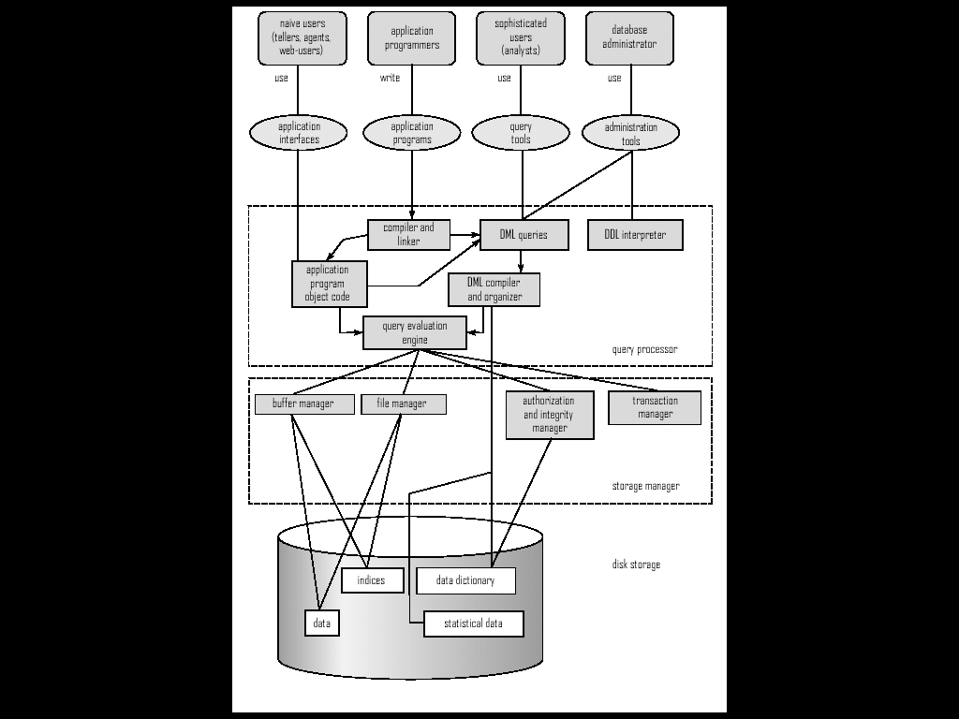
Database Architecture

Slide 28
Database Architecture
The architecture of a database system is greatly influenced by the computer system on which the database system runs
Database can be centralized or client-server
In client server architecture, one server machine executes work on be half of multiple client machines
Database applications are usually partitioned into two tier architecture and three tier architecture
DATABASE SYSTEM

Slide 29
Database Architecture
In a two tier architecture, the application is partitioned into a component that resides at the client machine which invokes database system functionality at the server machine through query language statements
Application program interface standards like ODBC and JDBC are used for interaction between the client and the server
DATABASE SYSTEM

Slide 30
Database Architecture
In three tier architecture, the client machine acts as a front end and does not contain any direct database call
The client end communicates with an application server.
The application server in turn communicates with a database system to access data.
DATABASE SYSTEM

Slide 31
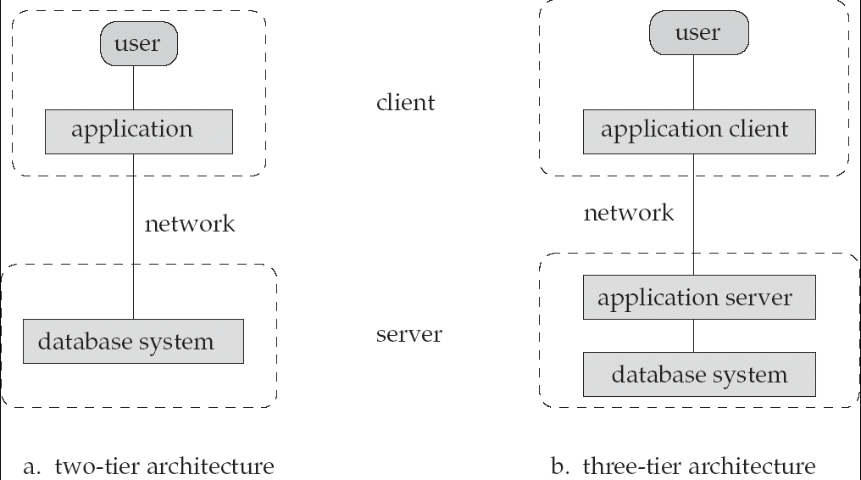
Database Application Architectures
(web browser)
Old
Modern
DATABASE SYSTEM

Slide 32
Database users and database administrator
People who work with a database can be categorized as database users or database administrators
Different types of database system users are
Naïve users: ATM card holder
Application programmers: computer professional who write application programs
Sophisticated users: form their requests in a database query language
Specialized users: who write specialized database applications e.g. expert system, CAD systems

Slide 33
Database administrator
DBMS have central control of both the data and the programs that access those data
A person who has such central control over the system is called a database administrator (DBA)
The function of DBA include:
Schema definition
Granting of authorization for data access
Routine maintenance
DATABASE SYSTEM

Slide 34
Data modeling
Objective:
What is data modeling?
Basic concepts in E-R model like entity, attributes , relationship, constraints & identifiers (keys)
E-R diagrams
EER diagrams
DATABASE SYSTEM

Slide 35
Data modeling
A data model is a plan for building a database.
Data modeling is the process of creating a data model by applying formal data model descriptions using data modeling techniques.
It is sometimes called database modeling because a data model is eventually implemented in a database.
The Entity-Relation Model (ER) is the most common method used to build data models
DATABASE SYSTEM

Slide 36
Entity-Relationship (E-R) Modeling
Key Terms
  Entity:
  An entity can be a person, place, object, event or concept in the user environment about which the organization wishes to maintain data
Real-world object distinguishable from other objects
e.g a student, car, job, subject, building ...
EMPLOYEE
DATABASE SYSTEM

Slide 37
Entity Sets
A collection of similar entities (e.g. all employees)
All entities in an entity set have the same set of attributes
Each entity set has a key
Each attribute has a domain
EMPLOYEES
SSN | NAME | SAL
321-23-3241 | Kim | 23,000
645-56-7895 | Jones | 45,000
DATABASE SYSTEM

Slide 38
  Entity Type:
  A collection of entities that share common properties or characteristics
Each Entity Type is described by its NAME and attributes
The Entity Type describes the “Schema” or “Intension” for a set of entities
Collection of all entities of a particular entity type at a given point in time is called the “Entity Set” or “Extension” of an Entity Type
name
SSN
sal
DATABASE SYSTEM
EMPLOYEE

Slide 39
Attributes
  A named property or characteristic of an entity that is of interest to an organization
Attribute Types
– Composite Vs. Simple Attributes
– Single-valued Vs. Multi-valued Attributes
– Derived attributes
_ Key attributes
name
SSN
sal
DATABASE SYSTEM
EMPLOYEE

Slide 40
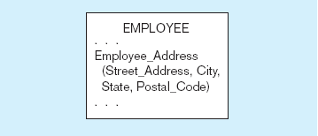
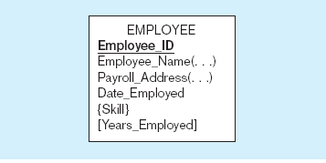
A composite attribute
An attribute broken into component parts
Entity with multivalued attribute (Skill)
and derived attribute (Years_Employed)
Multivalued
an employee can have
more than one skill
Derived
from date employed and current date
DATABASE SYSTEM
Notes:
12

Slide 41
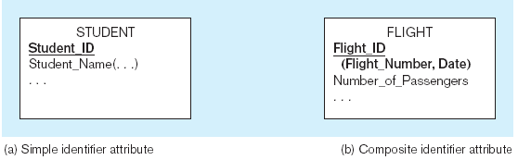
Simple and composite identifier attributes
The identifier is boldfaced and underlined
DATABASE SYSTEM
Notes:
14

Slide 42
Relationship:
  Relationship instance–link between entities (corresponds to primary key-foreign key equivalencies in related tables)
  Relationship type–category of relationship…link between entity types
DATABASE SYSTEM

Slide 43
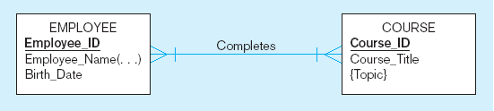
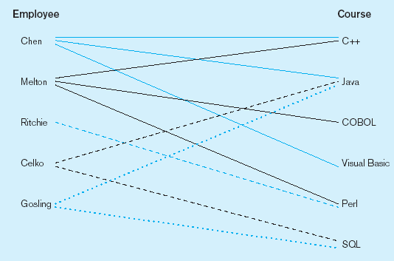
Relationship types and instances
a) Relationship type
b) Relationship instances
DATABASE SYSTEM
Notes:
17

Slide 44
Degree of Relationships
Degree of a relationship is the number of entity types that participate in it
  Unary Relationship
  Binary Relationship
  Ternary Relationship
DATABASE SYSTEM
Notes:
16

Slide 45
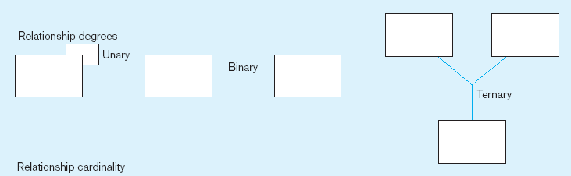
Degree of relationships
Entities of two different types related to each other
One entity related to another of the same entity type
Entities of three different types related to each other
DATABASE SYSTEM
Notes:
8

Slide 46
Recursive Relationships
Same entity type can participate more than once in the same relationship type under different “roles”
Such relationships are called
“Recursive Relationships”
Employees
Recursive
Relationship
Supervisor
Subordinate
Supervision
DATABASE SYSTEM

Slide 47
Cardinality of Relationships
One-to-One
  Each entity in the relationship will have exactly one related entity
One-to-Many
  An entity on one side of the relationship can have many related entities, but an entity on the other side will have a maximum of one related entity
Many-to-Many
  Entities on both sides of the relationship can have many related entities on the other side
DATABASE SYSTEM

Slide 48
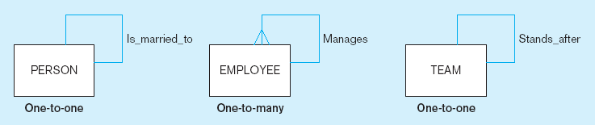
Examples of relationships of different degrees
a) Unary relationships
DATABASE SYSTEM
Notes:
22

Slide 49
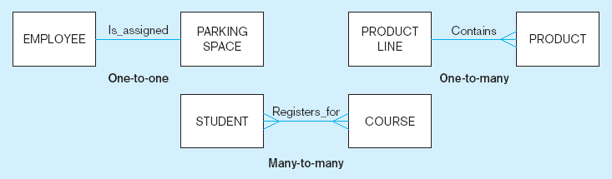
Examples of relationships of different degrees (cont.)
b) Binary relationships
DATABASE SYSTEM
Notes:
22

Slide 50
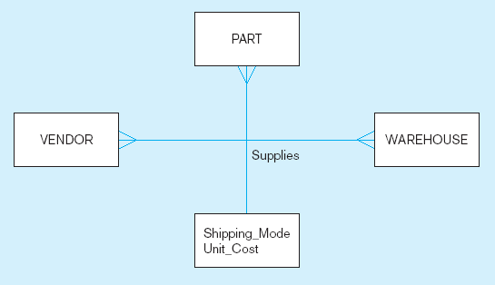
Examples of relationships of different degrees (cont.)
c) Ternary relationship
Note: a relationship can have attributes of its own
DATABASE SYSTEM
Notes:
22

Slide 51
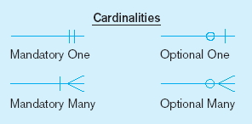
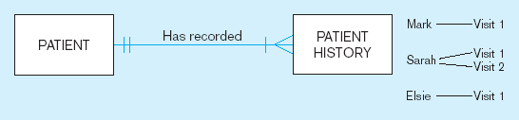
Examples of cardinality constraints
a) Mandatory cardinalities
A patient history is recorded for one and only one patient
A patient must have recorded at least one history, and can have many
DATABASE SYSTEM
Notes:
1

Slide 52
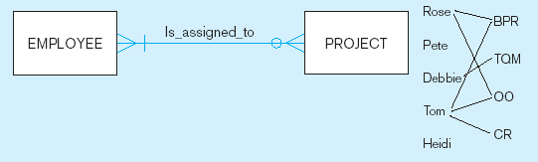
Examples of cardinality constraints (cont.)
b) One optional, one mandatory
A project must be assigned to at least one employee, and may be assigned to many
An employee can be assigned to any number of projects, or may not be assigned to any at all
DATABASE SYSTEM
Notes:
1

Slide 53
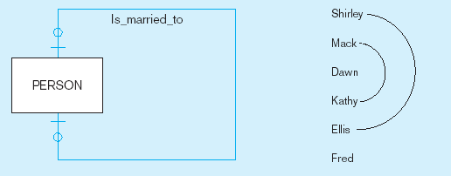
Examples of cardinality constraints (cont.)
c) Optional cardinalities
A person is is married to at most one other person, or may not be married at all
DATABASE SYSTEM
Notes:
1

Slide 54
Strong vs. Weak Entities, and
Identifying Relationships
Strong entities
  exist independently of other types of entities
  has its own unique identifier
  identifier underlined with single-line
Weak entity
  dependent on a strong entity (identifying owner)…cannot exist on its own
  does not have a unique identifier (only a partial identifier)
  Partial identifier underlined with double-line
  Entity box has double line
Identifying relationship
  links strong entities to weak entities
DATABASE SYSTEM

Slide 55
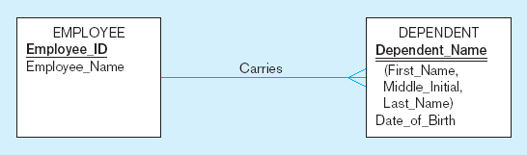
Identifying relationship
Strong entity
Weak entity
DATABASE SYSTEM

Slide 56
Identifier (Key)
A key is an attribute or a combination of attributes that is used to identify records.
Sometimes we might have to retrieve data from more than one table, in those cases we require to join tables with the help of keys
The purpose of the key is to bind data together across tables without repeating all of the data in every table.
The various types of key are mentioned in next slides, (For examples let suppose we have table -
Student (‘student_ID’, ‘FName’, ’LName’, ’Course_ID’)
DATABASE SYSTEM

Slide 57
(I) Super Key – An attribute or a combination of attribute that is used to identify the records uniquely is known as Super Key. A table can have many Super Keys.
E.g. of Super Key
1 Student_ID
2 Student_ID, FName
3 Student_ID, FName, Lname
4 Student_ID, FName, Lname, course_ID
5 Fname, LName
So on as any combination which can identify the records uniquely will be a Super Key.
DATABASE SYSTEM

Slide 58
(II) Candidate Key – It can be defined as minimal Super Key or irreducible Super Key. In other words an attribute or a combination of attribute that identifies the record uniquely but none of its proper subsets can identify the records uniquely.
One can describe a candidate key as a super key that contains only the minimum number of columns necessary to determine uniqueness.
E.g. of Candidate Key
1. Student_ID that uniquely identifies the students in a student table
2. FName, Lname when combined, uniquely identify the student in a student table
These would both be candidate keys.
DATABASE SYSTEM

Slide 59
In order to be eligible for a candidate key it must pass certain criteria.
It must contain unique values
It must not contain null values
It contains the minimum number of fields to ensure uniqueness
It must uniquely identify each record in the table
DATABASE SYSTEM

Slide 60
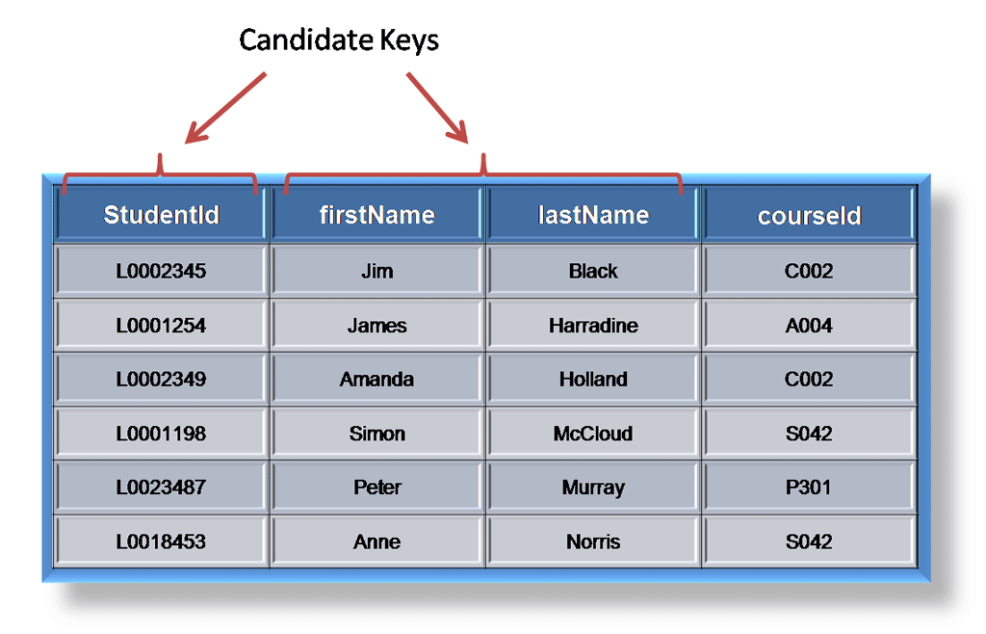
DATABASE SYSTEM

Slide 61
(III) Primary Key – A Candidate Key that is used by the database designer for unique identification of each row in a table is known as Primary Key. A Primary Key can consist of one or more attributes of a table.
As with any candidate key the primary key must contain unique values, must never be null and uniquely identify each record in the table.
E.g. of Primary Key –
a student id might be a primary key in a student table
DATABASE SYSTEM

Slide 62
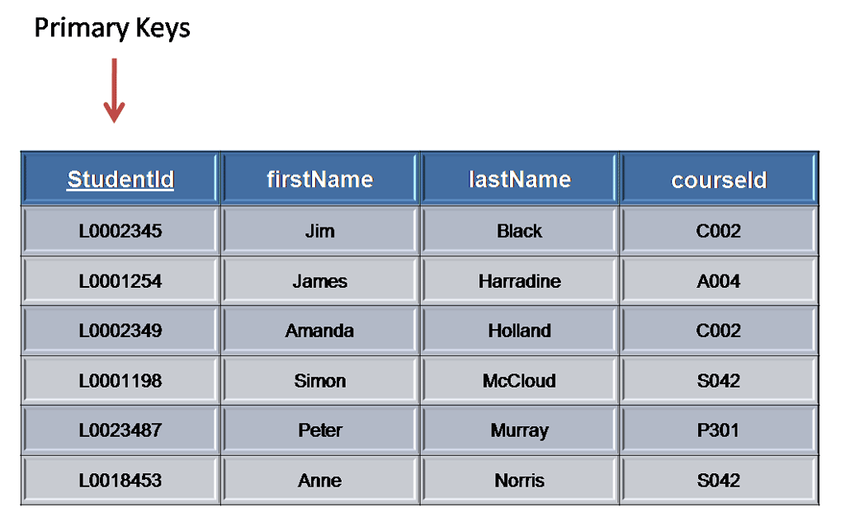
DATABASE SYSTEM

Slide 63
(IV) Foreign Key – A foreign key is an attribute or combination of attribute in one base table that points to the candidate key (generally it is the primary key) of another table. The purpose of the foreign key is to ensure referential integrity of the data i.e. only values that are supposed to appear in the database are permitted.
DATABASE SYSTEM

Slide 64
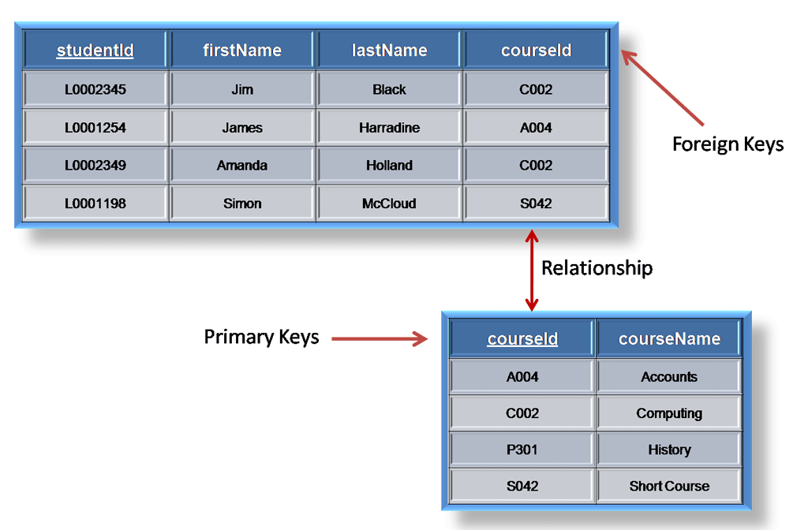
DATABASE SYSTEM

Slide 65
(V) Composite Key – If we use multiple attributes to create a Primary Key then that Primary Key is called Composite Key (also called a Compound Key or Concatenated Key).
E.g. of Composite Key, if we have used “FName, LName” as a Primary Key then it will be our Composite Key.
When choosing a primary key from the pool of candidate keys always choose a single simple key over a composite key.
DATABASE SYSTEM

Slide 66
(VI) Alternate Key – Alternate Key can be any of the Candidate Keys except for the Primary Key.
E.g. of Alternate Key is “FName, LName” as it is the only other Candidate Key which is not a Primary Key
DATABASE SYSTEM

Slide 67
(VII) Secondary Key – The attributes that are not even the Super Key but can be still used for identification of records (not unique) are known as Secondary Key.
E.g. of Secondary Key can be Name, Address, Salary, Department_ID etc. as they can identify the records but they might not be unique.
DATABASE SYSTEM

Slide 68
E R diagram
Entity-Relationship (E-R) Diagram
  A detailed, logical representation of the entities, associations and data elements for an organization or business
DATABASE SYSTEM

Slide 69
Notation Guide
ENTITY TYPE
WEAK ENTITY TYPE
RELATIONSHIP TYPE
IDENTIFYING RELATIONSHIP TYPE
DATABASE SYSTEM

Slide 70
… Notation Guide
ATTRIBUTE
KEY ATTRIBUTE
MULTIVALUED ATTRIBUTE
DERIVED ATTRIBUTE
COMPOSITE ATTRIBUTE
_____
. . .
DATABASE SYSTEM

Slide 71
ER Diagram Basics
Entity
sname
Store
Locations
Relationship
manager
qty
Keeps
Attributes
pname
Product
price
descrip
DATABASE SYSTEM

Slide 72
E-R Diagram Example
Example: A library database contains a listing of authors that have written books on various subjects (one author per book). It also contains information about libraries that carry books on various subjects.
  Entity sets: authors, subjects, books, libraries
  Relationship sets: wrote, carry, indexed
Subject
matter
title
isbn
SS#
authors
wrote
books
index
subject
name
quantity
carry
address
libraries
DATABASE SYSTEM

Slide 73
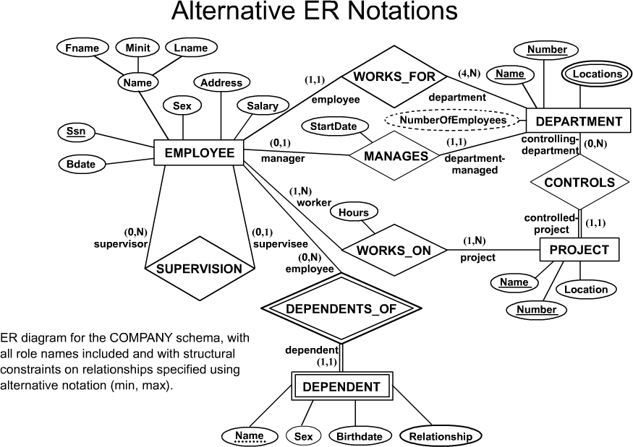
Converting an E-R Diagram into tables
DATABASE SYSTEM

Slide 74
STEP 1: For each non-weak entity, create a relation (or table) that includes all of the simple attributes of that entity.
Do not include multivalued attributes or derived attributes at this time. If you have a composite attribute, include only the component attributes.
Choose one of the candidate keys to be the primary key of the table.
DATABASE SYSTEM

Slide 75
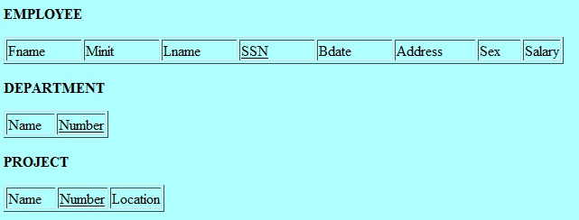
DATABASE SYSTEM

Slide 76
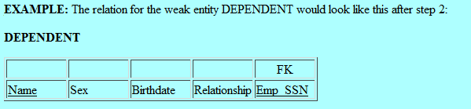
STEP 2: For each weak entity, create a relation that includes all simple attributes v of the weak entity.
In addition, include as a foreign key attribute the primary key of the owning entity.
The primary key of this relation will be the combination of the primary key of the owning entity and the partial key of the weak entity.

Slide 77
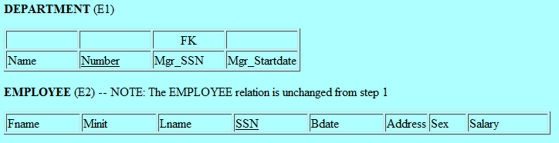
STEP 3: For each binary 1:1 relationship, identify the two entities (E1, E2) that participate in that relationship. Take the primary key from E2 and include it as a foreign key in E1(double line). If the relationship has simple attributes, include those in the relation for E1.

Slide 78
STEP 4: For each non-weak binary 1:N relationship, identify the entity E1 that is at the N-side (the "many" side) of the relationship. The other entity in the relationship is E2. Include as a foreign key in E1 the primary key of E2.
DATABASE SYSTEM

Slide 79
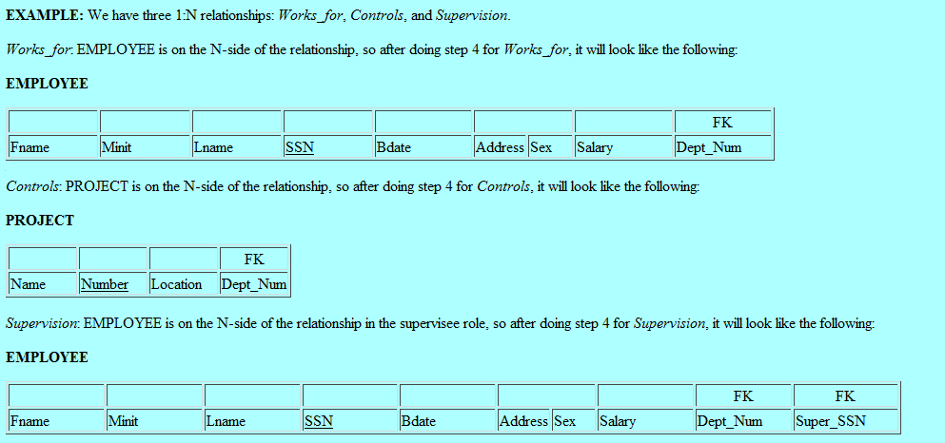
DATABASE SYSTEM

Slide 80
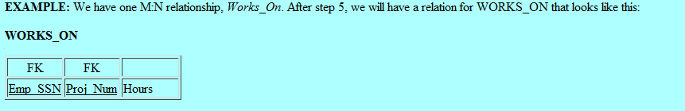
Step 5: For each binary M:N relationship, create a new relation to represent the relationship. Include in this relation as foreign keys the primary keys of each of the entities that participates in the relationship. The combination of these foreign keys will make up the primary key for the relation.
DATABASE SYSTEM

Slide 81
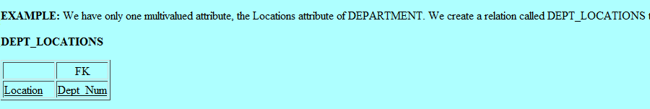
Step 6: For each multivalued attribute, create a new relation that includes that attribute, plus the primary key of the entity to whom that attribute belongs as a foreign key. The primary key of this new relation will be the combination of the foreign key and the attribute itself.
DATABASE SYSTEM

Slide 82
Enhanced-ER (EER) Model Concepts
Includes all modeling concepts of basic ER
Additional concepts: subclasses/superclasses, specialization/generalization, categories, attribute inheritance
The resulting model is called the enhanced-ER or Extended ER (E2R or EER) model
It is used to model applications more completely and accurately if needed
It includes some object-oriented concepts, such as inheritance
DATABASE SYSTEM

Slide 83
Subclasses and Super classes
An entity type may have additional meaningful subgroupings of its entities
Example: EMPLOYEE may be further grouped into SECRETARY, ENGINEER, MANAGER, TECHNICIAN, SALARIED_EMPLOYEE, HOURLY_EMPLOYEE,…
  Each of these groupings is a subset of EMPLOYEE entities
  Each is called a subclass of EMPLOYEE
  EMPLOYEE is the superclass for each of these subclasses
These are called superclass/subclass relationships.
Example: EMPLOYEE/SECRETARY, EMPLOYEE/TECHNICIAN
These are also called IS-A relationships (SECRETARY IS-A EMPLOYEE, TECHNICIAN IS-A EMPLOYEE, …).
DATABASE SYSTEM

Slide 84
Attribute Inheritance in Superclass / Subclass Relationships
An entity that is member of a subclass inherits all attributes of the entity as a member of the superclass
It also inherits all relationships
DATABASE SYSTEM

Slide 85
Specialization
This is the process of maximising the differences between members of an entity by identifying their distinguishing characteristics.
Staff(staff_no,name,address,dob)
Manager(bonus)
Secretary(wp_skills)
Sales_personnel(sales_area, car_allowance)
Specialization constructs the lower level entity sets that are a subset of a higher level entity set.
DATABASE SYSTEM

Slide 86
Generalisation
Generalisation is the process of minimising the differences between entities by identifying common features.
This is the identification of a generalised superclass from the original subclasses. This is the process of identifying the common attributes and relationships.
DATABASE SYSTEM

Slide 87
Generalization and Specialization
  Arrow pointing to the generalized superclass represents a generalization
  Arrows pointing to the specialized subclasses represent a specialization
  We do not use this notation because it is often subjective as to which process is more appropriate for a particular situation
  We advocate not drawing any arrows in these situations
  A superclass or subclass represents a set of entities
  Shown in rectangles in EER diagrams (as are entity types)
  Sometimes, all entity sets are simply called classes, whether they are entity types, superclasses, or subclasses
DATABASE SYSTEM

Slide 88
GENERALIZATION AND SPECIALIZATION
student
sid
name
Generalization
is A
Specialization
Undergrad
graduate
DATABASE SYSTEM

Slide 89
Constraints on Specialization and Generalization
Two conditions apply to a specialization/generalization:
Disjointness Constraint:
  Specifies that the subclasses of the specialization must be disjointed (an entity can be a member of at most one of the subclasses of the specialization)
  Specified by d in EER diagram
  If not disjointed, overlap; that is the same entity may be a member of more than one subclass of the specialization
  Specified by o in EER diagram
Completeness Constraint:
  Total specifies that every entity in the superclass must be a member of some subclass in the specialization/ generalization
  Shown in EER diagrams by a double line
  Partial allows an entity not to belong to any of the subclasses
  Shown in EER diagrams by a single line
DATABASE SYSTEM

Slide 90
Constraints on Specialization and Generalization
Hence, we have four types of specialization/generalization:
  Disjoint, total
  Disjoint, partial
  Overlapping, total
  Overlapping, partial
Note: Generalization usually is total because the superclass is derived from the subclasses.
DATABASE SYSTEM

Slide 91
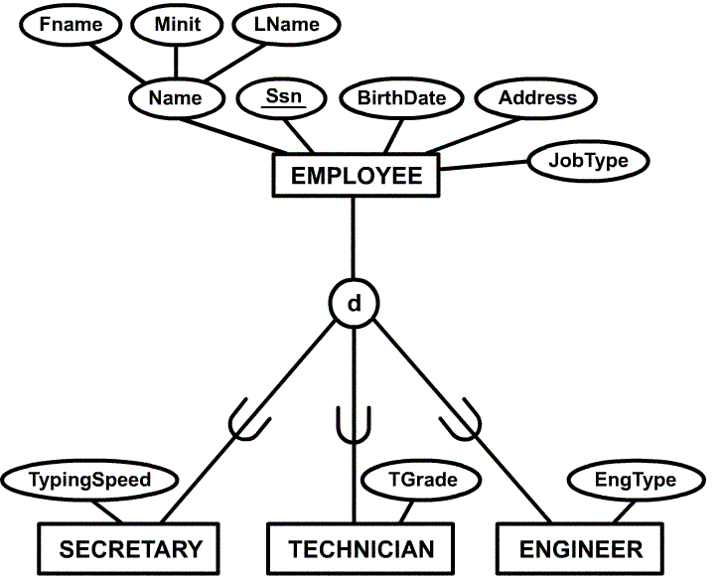
DATABASE SYSTEM

Slide 92
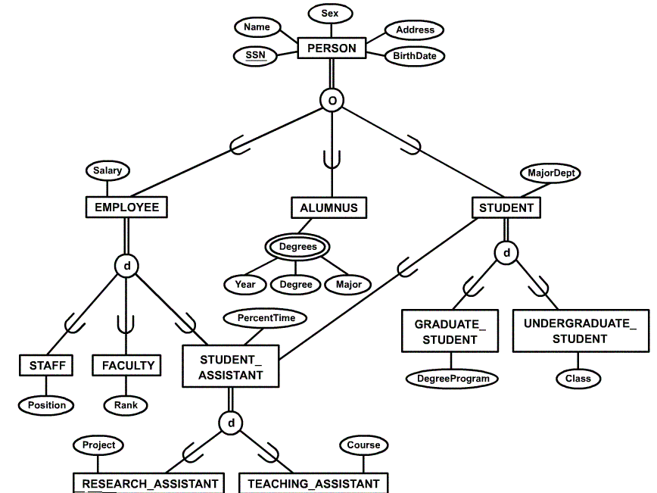
Specialization / Generalization Example (UNIVERSITY)
DATABASE SYSTEM

Slide 93
Relational model
Objective:
What is relational model?
Codd’s rule
Different types of constraints
  Nulls, Entity, Referential Integrities, Enterprise Constraints
Schema diagram
DATABASE SYSTEM

Slide 94
What is Relational Model?
Relational model is most widely used data model for commercial data-processing. The reason it’s used so much is, because it’s simple and easy to maintain.
The model is based on a collection of tables. Users of the database can create tables, insert new tables or modify existing tables.
DATABASE SYSTEM

Slide 95
History of Relational Modeling
Introduced by Ted Codd in 1970
Ted Codd was an IBM Researcher laid the foundation for database theory
Many database concepts & products based on his model
DATABASE SYSTEM

Slide 96
Relational Model
Relational model provides
A simple, limited approach to structuring
data, yet is reasonably flexible
Easy to query without programming
A limited, yet useful, collection of operations on data
Good design is essential
Integrity is essential
DATABASE SYSTEM

Slide 97
Relational Model Basic
The relational model gives us a single way to represent data: as a two-dimensional table called a relation.
Attributes
Schemas
Tuples
Domains
DATABASE SYSTEM

Slide 98
Attributes
Attributes of a relation serve as names for the columns of the relation. Usually, an attribute describes the meaning of entries in the column below.
Table = relation.
Column headers = attributes.
Attribute
Title | Year | Length
Star Wars | 1977 | 124
Might Ducks | 1991 | 104
Wayne’s World | 1992 | 95
DATABASE SYSTEM

Slide 99
Schemas
The name of a relation and the set of attributes for a relation is called a schema.
We show the schema for the relation with the relation name followed by a parenthesized list of its attributes.
So the schema for previous slide is
Movies (title, year, length)
DATABASE SYSTEM

Slide 100
Tuples
The rows of a relation, other than the header row containing
The attribute names are called tuples.
A tuple has one component for each attribute of the relation.
Title | Year | Length
Star Wars | 1977 | 124
Might Ducks | 1991 | 104
Wayne’s World | 1992 | 95
Tuple
DATABASE SYSTEM

Slide 101
Domains
Each attribute of a relation is associated with a particular elementary type called domain.
The components of any tuple of the relation must have, in each component, a value that belongs to the domain of the corresponding column.
Example:
  with title string is associated
  with year integer is associated
DATABASE SYSTEM

Slide 102
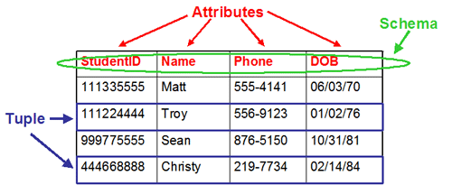
Relational Model Example
Represent data as a two-dimensional table called a relation
DATABASE SYSTEM

Slide 103
Codd’s Rules
Codd's 12 rules are a set of rules proposed by E. F. Codd, a pioneer of the relational model for databases, designed to define what is required from a database management system in order for it to be considered relational
For a system to qualify as a relational database management system (RDBMS), that system must use its relational facilities to manage the database.
DATABASE SYSTEM

Slide 104
Codd’s Rules
Rule 1: The information rule:
  All information in the database is to be represented in one and only one way, namely by values in column positions within rows of tables.
Rule 2: The guaranteed access rule:
  All data must be accessible. This rule is essentially a restatement of the fundamental requirement for primary keys.
Rule 3: Systematic treatment of null values:
  The DBMS must allow each field to remain null (or empty). Specifically, it must support a representation of "missing information and inapplicable information", distinct from all regular values, and independent of data type. It is also implied that such representations must be manipulated by the DBMS in a systematic way.
DATABASE SYSTEM

Slide 105
Codd’s Rules
Rule 4: Active online catalog based on the relational model:
  The system must support an online, inline, relational catalog that is accessible to authorized users by means of their regular query language. That is, users must be able to access the database's structure (catalog) using the same query language that they use to access the database's data.
Rule 5: The comprehensive data sublanguage rule:
  The system must support at least one relational language that
        Has a linear syntax
        Can be used both interactively and within application programs,
        Supports data definition operations (including view definitions), data manipulation operations (update as well as retrieval), security and integrity constraints, and transaction management operations (begin, commit, and rollback).
Rule 6: The view updating rule:
  All views that are theoretically updatable must be updatable by the system.
DATABASE SYSTEM

Slide 106
Codd’s Rules
Rule 7: High-level insert, update, and delete:
  The system must support set-at-a-time insert, update, and delete operators. This means that data can be retrieved from a relational database in sets constructed of data from multiple rows and/or multiple tables. This rule states that insert, update, and delete operations should be supported for any retrievable set rather than just for a single row in a single table.
Rule 8: Physical data independence:
  Changes to the physical level (how the data is stored, whether in arrays or linked lists etc.) must not require a change to an application based on the structure.
Rule 9: Logical data independence:
  Changes to the logical level (tables, columns, rows, and so on) must not require a change to an application based on the structure. Logical data independence is more difficult to achieve than physical data independence.
DATABASE SYSTEM

Slide 107
Codd’s Rules
Rule 10: Integrity independence:
  Integrity constraints must be specified separately from application programs and stored in the catalog. It must be possible to change such constraints as and when appropriate without unnecessarily affecting existing applications.
Rule 11: Distribution independence:
  The distribution of portions of the database to various locations should be invisible to users of the database. Existing applications should continue to operate successfully :
        when a distributed version of the DBMS is first introduced; and
        when existing distributed data are redistributed around the system.
Rule 12: The nonsubversion rule:
  If the system provides a low-level (record-at-a-time) interface, then that interface cannot be used to subvert the system, for example, bypassing a relational security or integrity constraint.
DATABASE SYSTEM

Slide 108
Integrity Constraints
Data integrity allows to define certain data quality requirements that the data in the database needs to meet. If a user tries to insert data that doesn't meet these requirements, Oracle will not allow so.
Integrity constraints provides a way of ensuring that changes made to the database by the authorized users do not result in a loss of data consistency
DATABASE SYSTEM

Slide 109
Integrity Constraints
Constraint types
There are many integrity constraints in database
  Null/ Not Null
  Unique
  Entity integrity
  Referential integrity
  Check
  Default
DATABASE SYSTEM

Slide 110
Not Null:
  A column in a table can be specified not null. It's not possible to insert a null in such a column.
Unique:
  The unique constraint doesn't allow duplicate values in a column. If the unique constraint encompasses two or more columns, no two equal combinations are allowed.
Check :
  A check constraint allows to state a minimum requirement for the value in a column. E.g. column in table allows only numbers that are between 0 and 100
DATABASE SYSTEM

Slide 111
Entity integrity constraint (Primary key):
  To identify each row in a table, the table must have a primary key.
  A primary key combines a unique and a not null constraint. A table can have at most one primary key
Referential integrity constraint (Foreign key )
  On a column ensures that the value in that column is found in the primary key of another table.
  Student(studno,name,tutor,year)
  Staff(lecturer,roomno,appraiser)
DATABASE SYSTEM

Slide 112
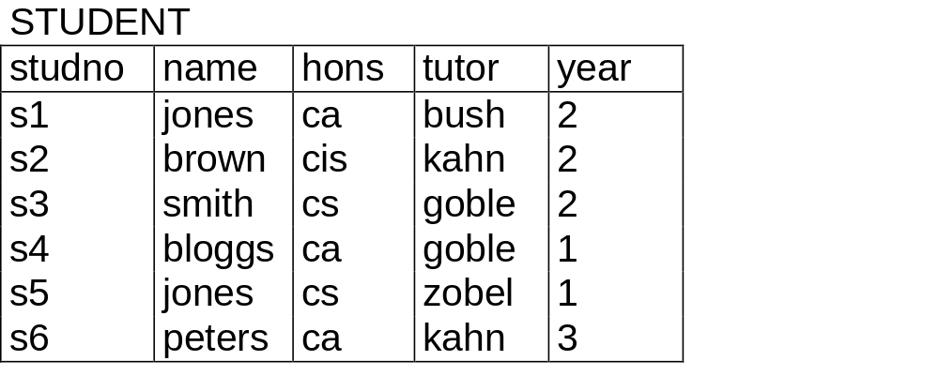
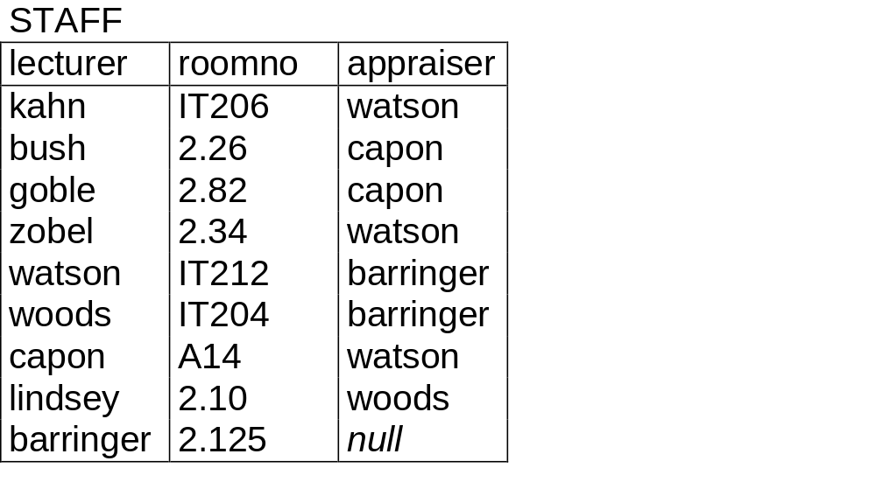
DATABASE SYSTEM

Slide 113
Relational databases schema and schema diagram
A relational database schema s is a set of relation schemas s={R1,R2, R3, …RM} and a set of integrity constraints
The figure in next slide shows a relational database schema
COMPANY = {Employee, department, dept_location, project, works_on}
The underlined attributes represent primary keys
DATABASE SYSTEM

Slide 114
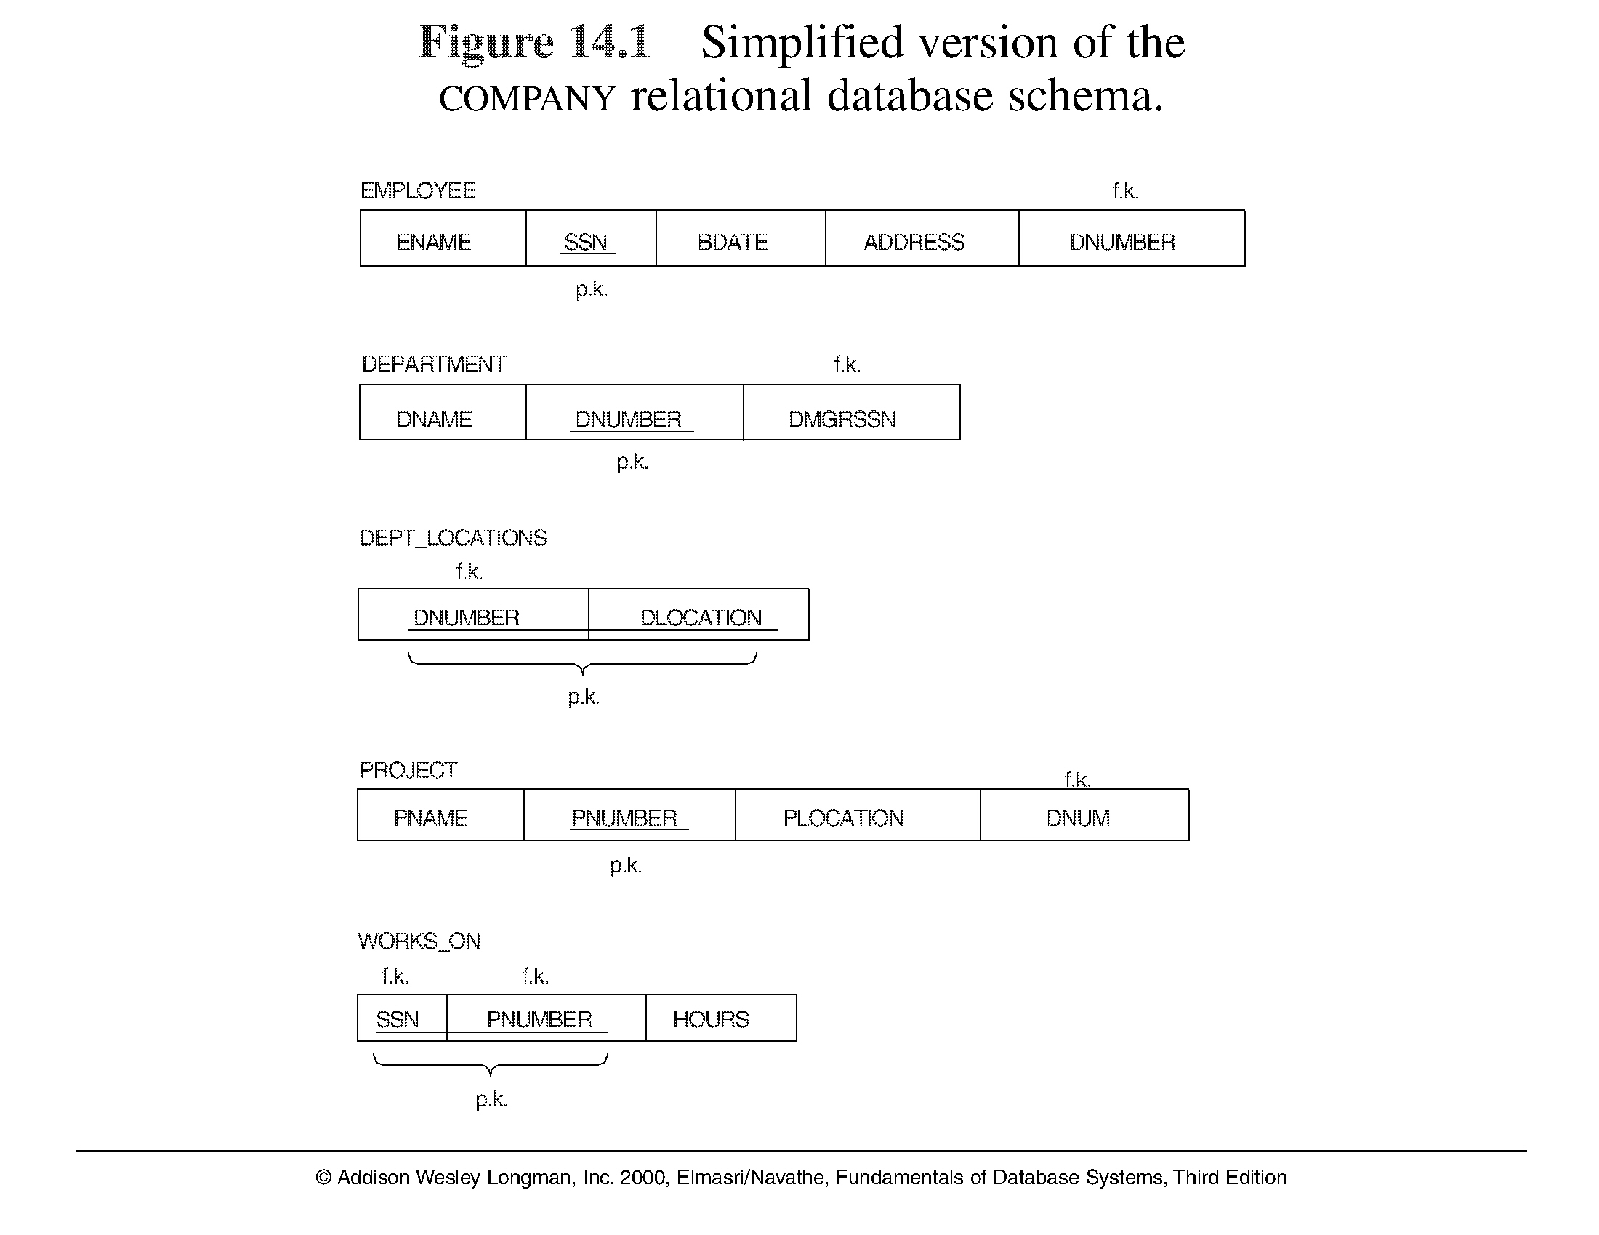
A simplified COMPANY relational database schema

